Slide 1
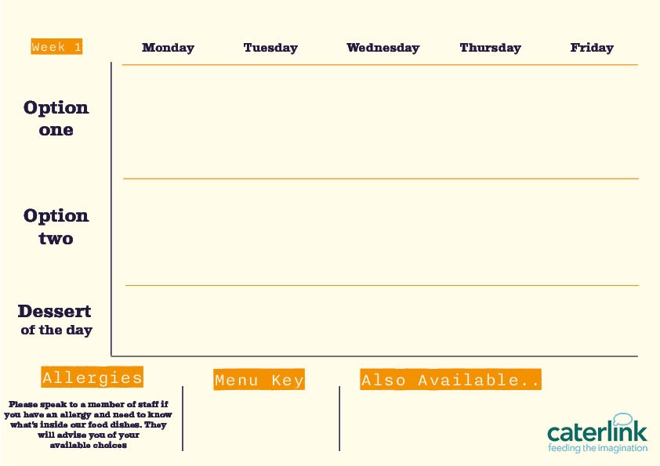






Spring Summer Menu 2026
Smokey Beef Chilli Tacos and Wedges
Served with Fresh salad
Jumbo hot dog with onions
Served with wedges
Fish Fillet
with Chips and choice of Peas, baked beans or curry sauce
Chicken Shawarma
Served with herby potatoes and Dips
Chicken
Tikka Masala
with rice & naan
Roasted veg & cheese tacos
Served with wedges
Quorn sausage with onions
Served with wedges
Chicken Sausage
with chips and choice of peas, baked beans or curry sauce
Vegetable flatbread
with herby potatoes and Dips
Vegetable Tikka Masala
with rice & naan
Selection of cakes and cookies
Selection of cakes and cookies
Selection of cakes and cookies
Selection of cakes and cookies
Selection of cakes and cookies
Main Meal £2.49
Main Meal Deal £2.75
Our hot and cold grab & go selection alongside Pasta of the day and filled jacket potatoes
Pizza slice £1.69
Large sausage roll £1.69
Bag of wedges £1.11

Slide 2


Spring Summer Menu 2026
BBQ Beef Sloppy Haywoods
with wedges
Fish Fillet
and Chips with choice of Peas, baked beans or curry sauce
Mac and Cheese with Toppings
Croutons, Pepperoni Pieces, Crispy Onions, Spring Onions, Barbecue Beans
Chicken Tikka Masala
with
Rice and
naan
Crispy chicken and cheese bake
with chips & veg
BBQ Veg
Sloppy Haywoods
with wedges
Chicken Sausage
with Chips and choice of peas, baked beans or curry sauce
Vegetable Tikka Masala
with Rice
and naan
Vegetarian
with Spicy Rice and Rainbow Slaw
Selection of cakes and cookies
Selection of cakes and cookies
Selection of cakes and cookies
Selection of cakes and cookies
Selection of cakes and cookies
Main Meal £2.49 Main meal Deal £2.75
Our hot and cold grab & go selection alongside pasta of the day and filled jacket potatoes
Pizza slice £1.69
Large sausage roll £1.69
Bag of wedges £1.11

Slide 3

Spring Summer Menu 2026
Classic Beef Lasagne
with garlic bread and salad
Spicy Chicken Burger
with wedges and salad
Fish Fillet
with Chips, Mushy Peas and Gravy or Curry Sauce
Meatball Sub
with chips and salad
Chicken Tikka Masala
with Rice and naan
Veg & Cheese Sub
With chips and salad
Veggie Lasagne
With garlic bread and salad
Vegetarian Burger
with wedges and salad
Chicken Sausage
with Chips and choice of Peas, baked beans or curry sauce
Vegetable Tikka Masala
with Rice and naan
Selection of cakes and cookies
Selection of cakes and cookies
Selection of cakes and cookies
Selection of cakes and cookies
Selection of cakes and cookies
Main Meal £2.49
Main Meal Deal £2.75
Our hot and cold grab & go selection alongside pasta of the day and filled jacket potatoes
Pizza slice £1.69
Large sausage roll £1.69
Bag of wedges £1.11

